Slide 1
Trans-Pacific Partnership
Overview and Assessment
March 2016

Slide 2
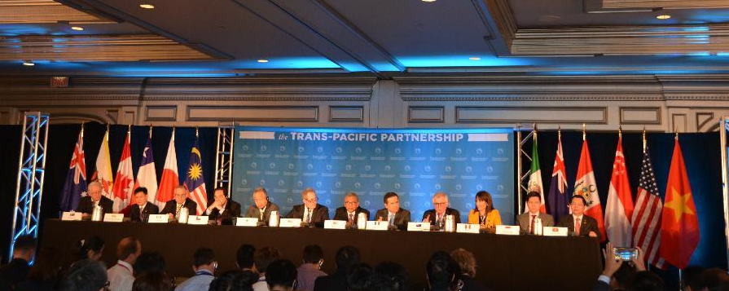
Australia, Brunei, Canada, Chile, Japan, Malaysia, Mexico, New Zealand, Peru, Singapore, United States, and Vietnam
Nearly 40% of the Global Economy

Slide 3
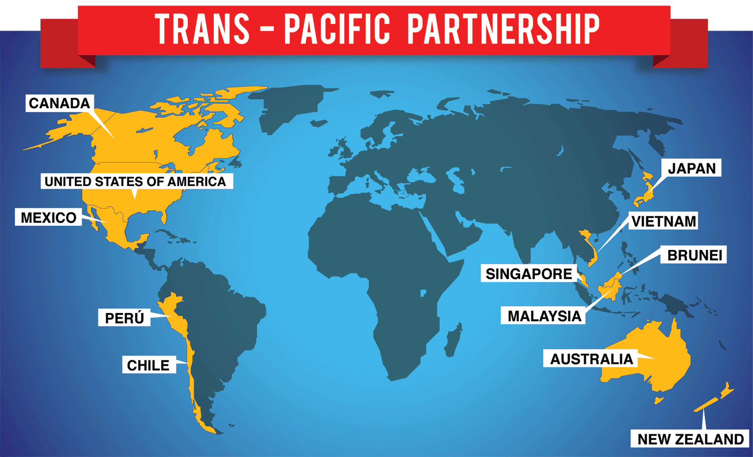
Other agreements:
14 Bi-lateral and Multi-lateral already signed by Vietnam
ASEAN FTAs traditionally focused on trade in goods
Vietnam has recently added South Korea and EU to long list of FTAs
TPP will exist alongside BTA, WTO and other agreements

Slide 4
RCEP and TPP: Complement or Compete?
ASEAN + 6 (Australia, China, India, Japan, Korea, New Zealand) pursuing Regional Comprehensive Economic Partnership (RCEP).
RCEP aims to broaden and deepen ASEAN pacts.
RCEP more countries but less ambitious.
TPP could have a bigger payoff for members
TPP can grow: South Korea, Thailand, Philippines, Taiwan, Indonesia – who will join next?

Slide 5
VN-US Trade after BTA, WTO and now TPP?
Vietnam-U.S. Trade, 2001 – 2015 est ($bil)
$40
$35
$30
$25
VN Imports fr USA
$20
VN Exports to USA
$15
Total Trade
$10
VN Apparel Exports
$5
$-

Slide 6
US – VN 2015 – Trade and Investment Trade:
Vietnam Exports - 2015 |  | Vietnam Imports - 2015 |  | Two way trade – Jan-Feb 2016
To US Up 17% | Global | From US Up 23% | Global | VN export to US | VN imports from US
$33 billion | $162 billion | $8 billion | $166 billion | $5 billion | $1 billion
Investment:
By the end of 2015:
US investor ranked 8 among 110 foreign countries and territories in Vietnam
781 existing projects worth US $11.3 billion.
By the end of Feb 2016:
791 existing Projects worth US $11.320 billion

Slide 7
Selected Provisions of Interest
– Goods — puts limits on some remaining protectionist measures
▪▪ Tariffs are generally eliminated or phased out
▪▪ Rule of origin are harmonized among members
National Treatment – domestic and foreign companies are equal
Services – also provided National Treatment
Agriculture – must have fair and scientific health and safety rules
Government procurement – allows some international bidding
Protection of intellectual property rights
Investment – level playing field for local and foreign investors
Labor and environment – must enforce the law and meet ILO standards
Customs – harmonize procedures among countries
SMEs – help small and medium size companies compete
SOEs – move SOEs towards more equal treatment with private sector companies

Slide 8
Why such large gains - Vietnam
Partners lower tariffs mean more exports of VN goods
Especially, VN currently pays very high duties to US on apparel and footwear if rules of origin can be met those tariffs will come down
More imports of consumer and production goods
More inward FDI due to investor optimism and new opportunity
Stronger links to global supply chains should attract supporting industries investment
Productivity gains from competition and higher standards
Momentum for reforms that boost growth and productivity
Big reputational boost putting Vietnam ahead of non-TPP countries
* Source: Petri, Plummer, Zhai, www.asiapacifictrade.org

Slide 9
Much to Gain - 2015 TPP Trade and Duties to U.S. TOTAL TPP Exports to U.S. = $836.6 billion TOTAL TPP Duties to U.S. = $6.0 billion Vietnam Exports 4% to U.S. = $37.4 billion Vietnam 47% of duties to U.S. = $2.8 billion
Vietnam is the #1 TPP duty payer to the U.S. at average duty rate of 7.5%.
Globally, only China pays more in duties - $14.3 billion at 3.0% average duty rate.

Slide 10
Textiles Apparel - Vietnam’s largest export to US
Tariff reductions
▪▪ 60% of exports will be duty free to US on day one
▪▪ Others phase out over 12 years period
Complex Rules of Origin
▪▪ Triple transformation “yarn forward” required for preferential treatment
▪ Investment needed - currently very little fabric in VN supply chain used in apparel heading for the US
▪▪ “Careful monitoring and detailed record keeping required

Slide 11
Footwear – tariffs agreement

Slide 12
Footwear - Rules of Origin
Change of Chapter (CC); or
Change of Tariff Heading (CTH) + RVC (Regional Value Content)
Uppers and parts of uppers (classified in HS 6406.10), completed uppers of HS 6406.90: production in Vietnam or imported from TPP countries, together with the ratio to meet RVC 45 % under the build-up method or 55% under build-down method
RVC will be limited on the using of materials such as leather, fabric which are imported from non- TPP territories

Slide 13
Retail - One of Vietnam’s largest growth areas
Tariff reductions mean:
▪▪ Some imports will come in at lower prices
▪▪ Some new imports will now be price competitive
New rules will mean:
▪▪ Selling pirated products will be a bigger no-no
▪▪ “Selling gray market or illegal imports could be judged as unfair competition by foreign retailers
▪▪ Economic needs test will be gone in five years
▪▪ Distribution rights will be expanded for foreign companies
▪▪ E-commerce will be more available
▪▪ Customs procedures will be further enhanced + harmonized

Slide 14
TPP Timing - Next Steps
TPP getting ready for ratification:
Ministers reached agreement Oct 5, 2015 in Atlanta, after 6 years of negotiations
Ministers signed Feb 4, 2016 in Auckland
Certified copies received March 1, 2016
Parliamentary procedures:
All countries must then follow their treaty ratification procedures
Each country must modify its laws and regulations and be in full compliance
US Congress vote hopefully 2016 for on both treaty and implementing bill
Vietnam in fall 2016, ratification, legal work completed end 2017
TPP will come into force:
60 days after all countries have ratify and are ready to implement, if within two years of signing
If all countries have not ratified within two years, agreement comes into force 60 days after 85% have ratified. Other TPP countries can come in once they have ratified and implemented commitments

Slide 15
Conclusions for Vietnam
The Challenges:
Companies aren't prepared for new rules and standards
Shortage of trained workers and soft infrastructure – accounting standards, too much cash in the economy, admin reform is behind
Hard infrastructure needed – power, roads, ports
Laws and regulatory compliance drags on too slowly
Administrative headaches and corruption deters growth regardless
Governments cannot pick winners and losers
Complexity of conflicting agreement – noodle bowl of tariffs and rules
Vietnam is better at volume than value - agriculture

Slide 16
Conclusions for Vietnam
The Benefits:
Could provide an immediate boost to Vietnam’s GDP, now
Sustain long-term growth
Strengthen regional supply chains and supporting industries
Attract FDI
Enhance business practices
Gives reform and modernization a beneficial path forward
Gives Vietnam competitive advantage in global supply chains
Gives Vietnam chance for great value chain development with
supporting industries
Enhances Vietnam’s geopolitical stature
New countries to join – VN

Slide 17
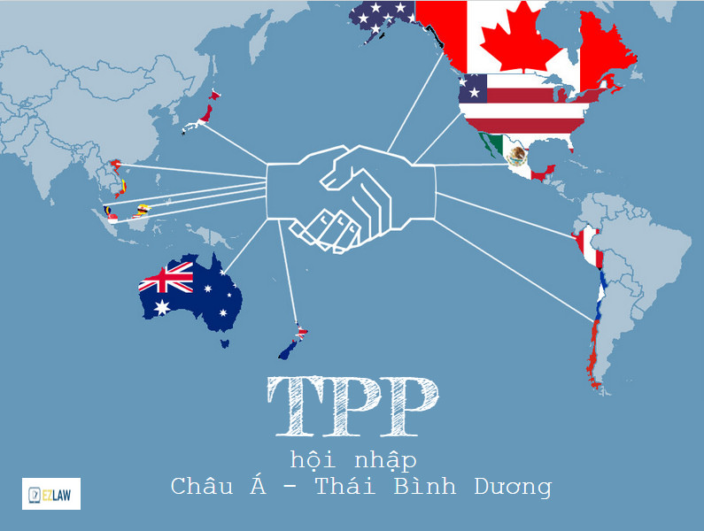
For Vietnam, TPP does not offer guarantees,
but it is an opportunity for great success.
Thank you

